Slide 1
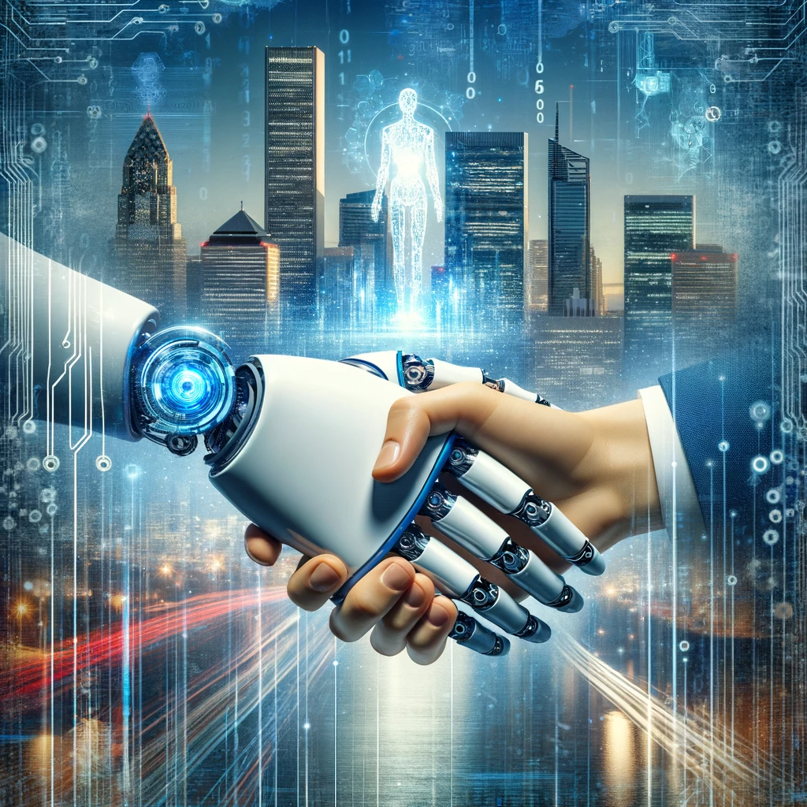
Understanding Artificial Intelligence

Slide 2
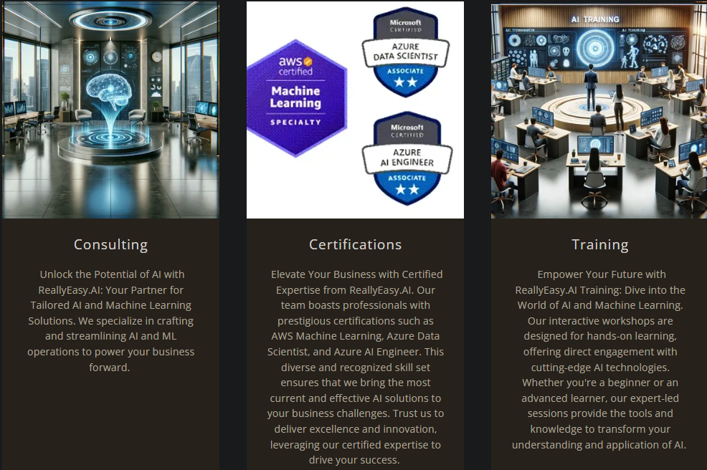

Slide 3
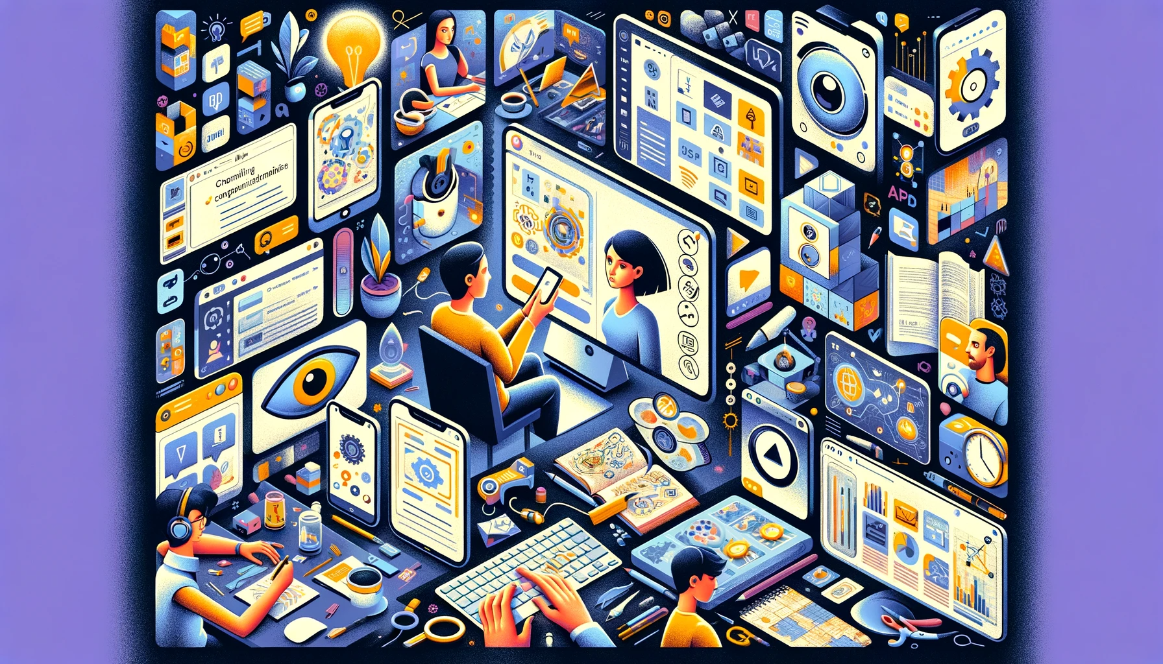
"Some people call this artificial intelligence, but the reality is this technology will enhance us. So instead of artificial intelligence, I think we’ll augment our intelligence."
- Ginni Rometty, Former CEO IBM

Slide 4
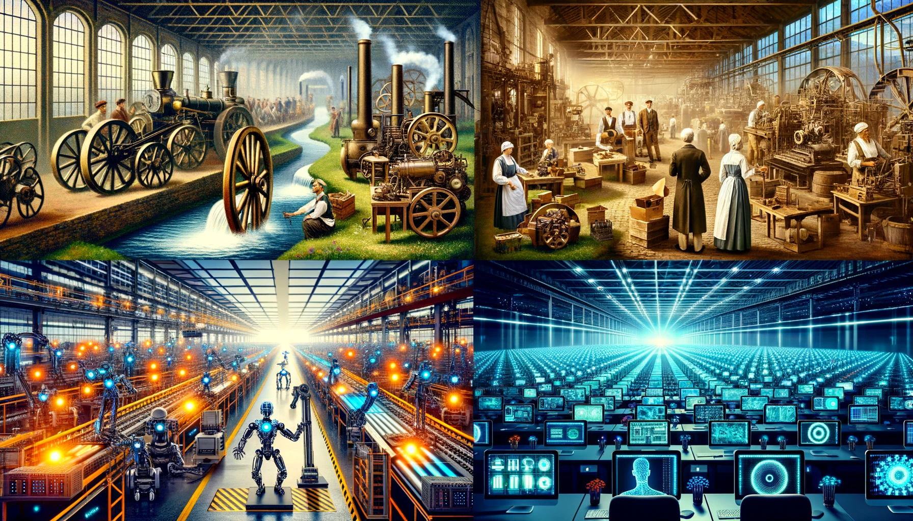
1.0 Mechanization, Steam, and Water Power
2.0 Mass Production and Electricity
3.0 Electronic / IT Systems and Automation
4.0 Cyber Physical Systems and
Artificial Intelligence
Notes:
https://www.forbes.com/sites/forbescoachescouncil/2023/10/30/generative-agile-leadership-what-the-fourth-industrial-revolution-needs/

Slide 5
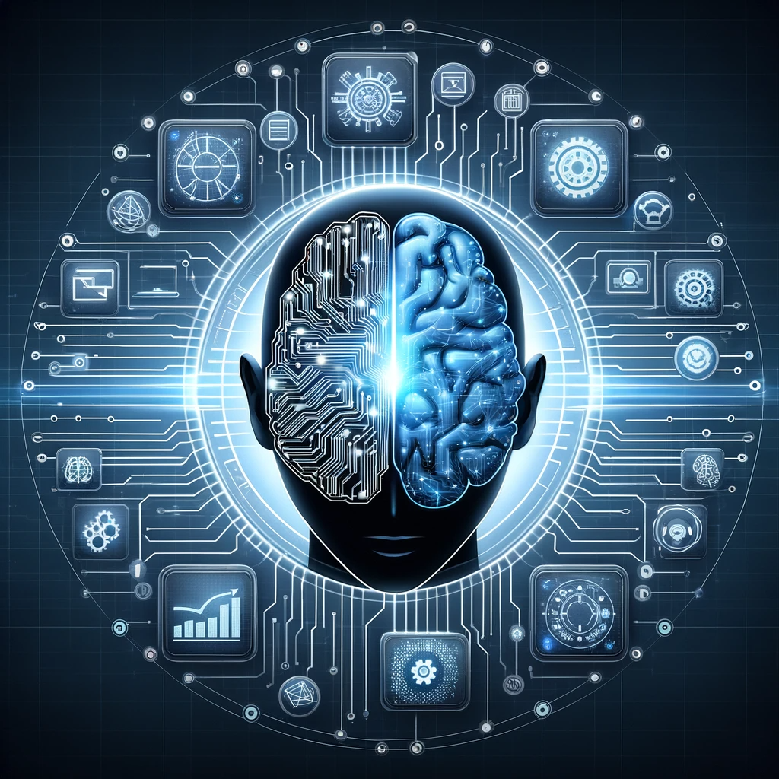
What is AI?

Slide 6
AI is the simulation of human intelligence processes by machines, especially computer systems.
These processes include:
Learning
Reasoning
Self-correction
Notes:
Definition produced by ChatGPT

Slide 7
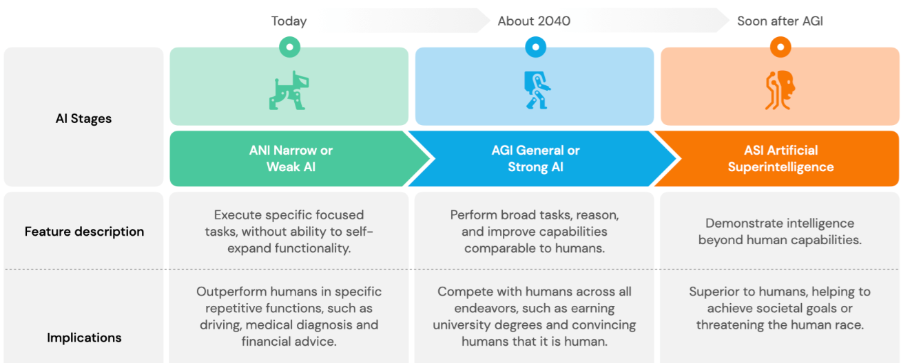
You Are Here
Notes:
https://hislide.io/product/3-type-of-artificial-intelligence-levels/

Slide 8
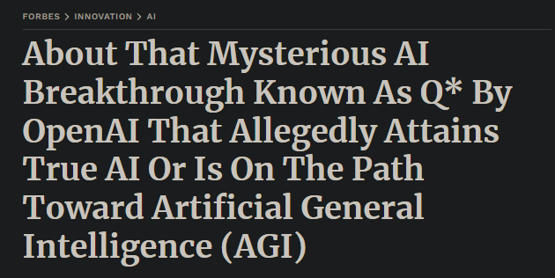
AGI in 2040? Maybe Sooner.
Notes:
https://www.forbes.com/sites/lanceeliot/2023/11/26/about-that-mysterious-ai-breakthrough-known-as-q-by-openai-that-allegedly-attains-true-ai-or-is-on-the-path-toward-artificial-general-intelligence-agi/

Slide 9
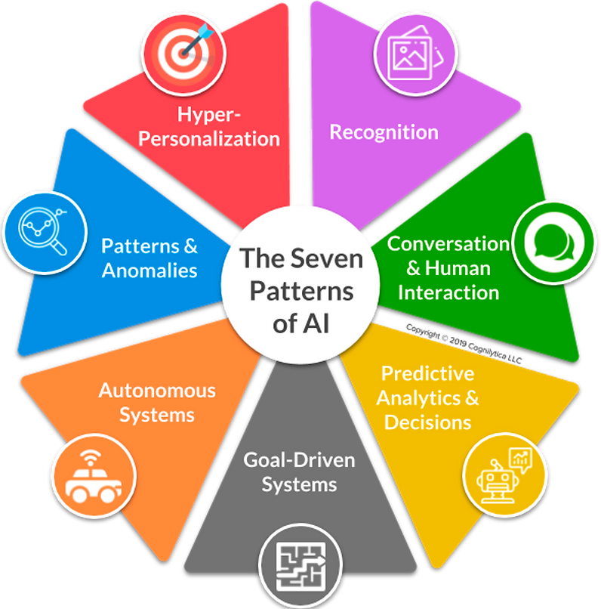
Notes:
https://mneguidelines.oecd.org/RBC-and-artificial-intelligence.pdf

Slide 10

Notes:
https://www.edureka.co/blog/ai-vs-machine-learning-vs-deep-learning/

Slide 11
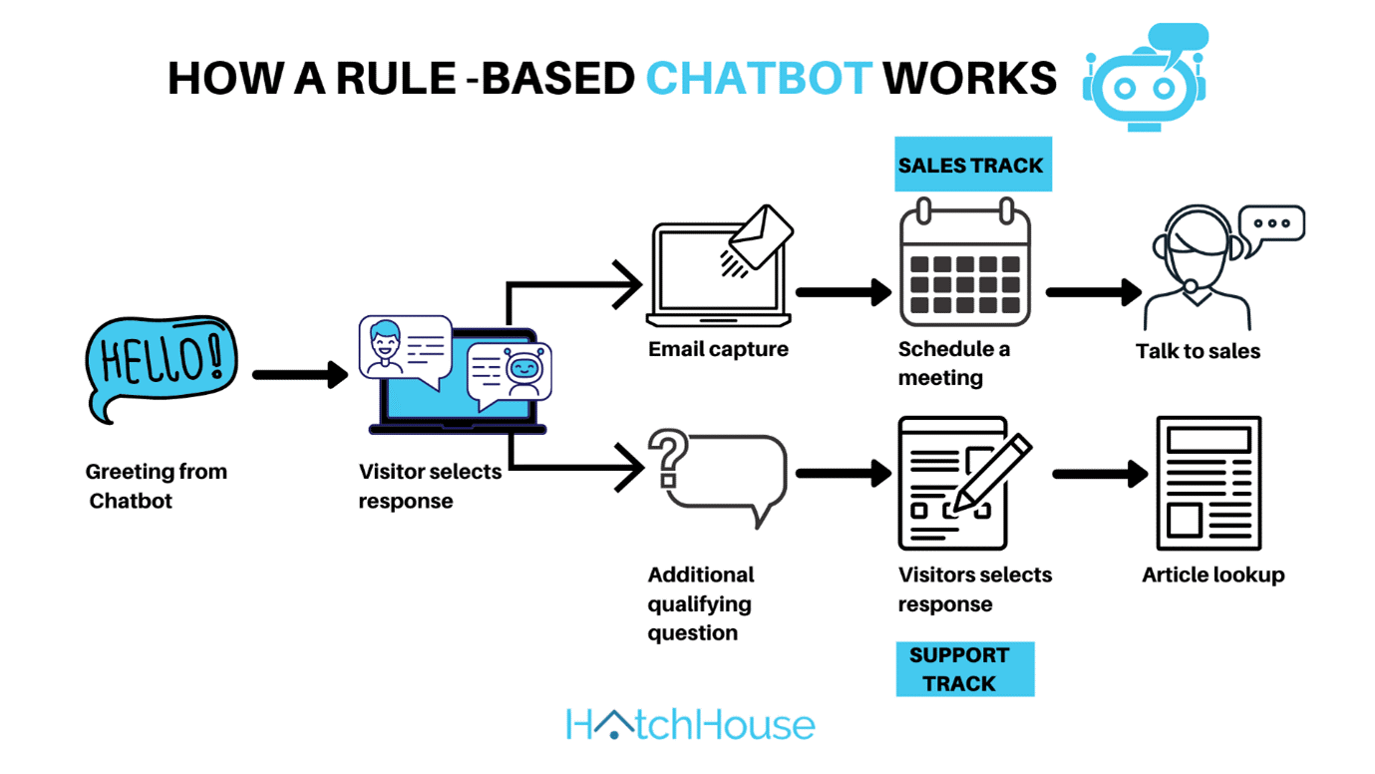
Simple AI: Rules-Based
Notes:
https://helpcrunch.com/blog/types-of-chatbots/

Slide 12
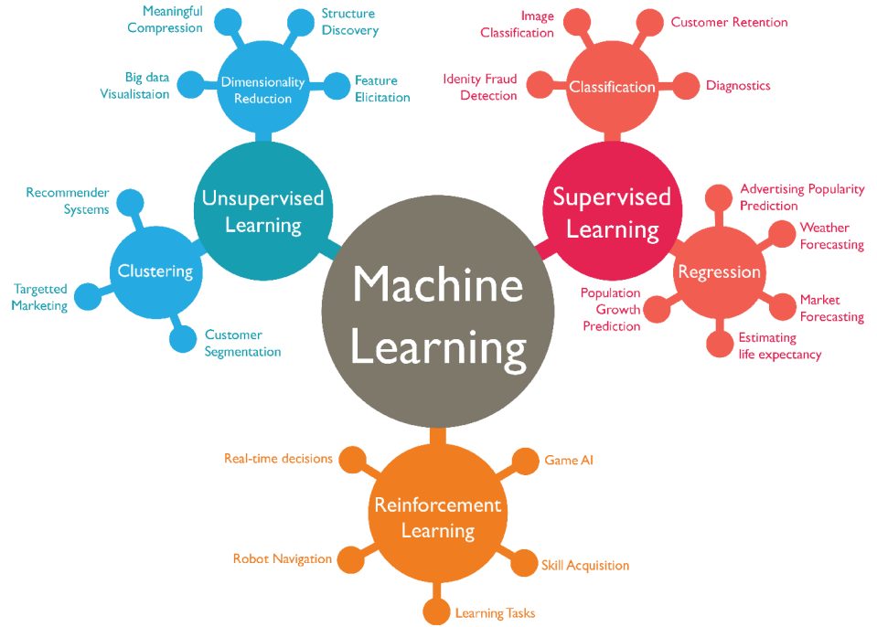
Notes:
https://medium.com/nerd-for-tech/dive-deep-into-machine-learning-66a39ce053b9

Slide 13
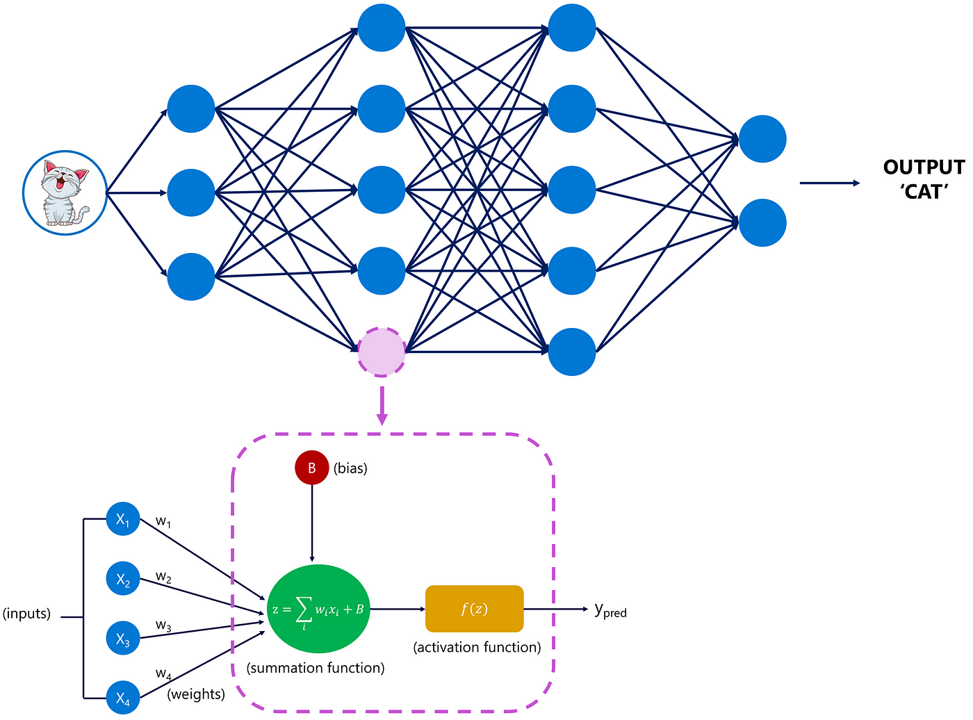
Notes:
https://medium.com/@margauxvanderplaetsen/the-journey-and-architecture-of-chatgpt-a-look-behind-the-scenes-ef35bed11072

Slide 14

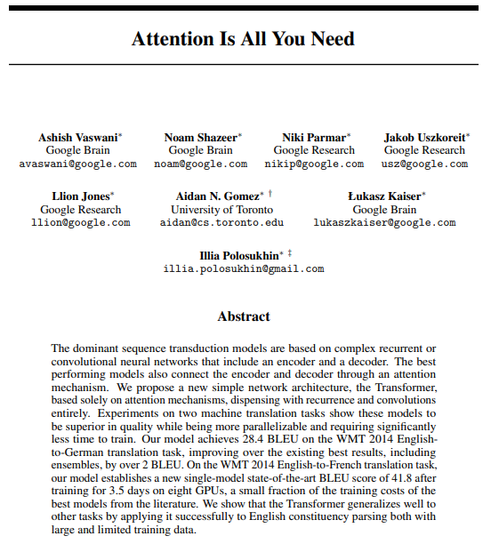
Super Duper Crazy Tech: transformers (more than meets the eye)
Notes:
https://arxiv.org/abs/1706.03762
https://builtin.com/artificial-intelligence/transformer-neural-network

Slide 15
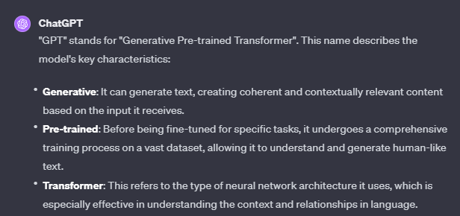

Slide 16
Relative Comparison of AI Deployments
Unsupervised
Learning
Generative AI
Reinforcement
Learning
Supervised
Learning
Notes:
https://www.youtube.com/watch?v=5p248yoa3oE

Slide 17
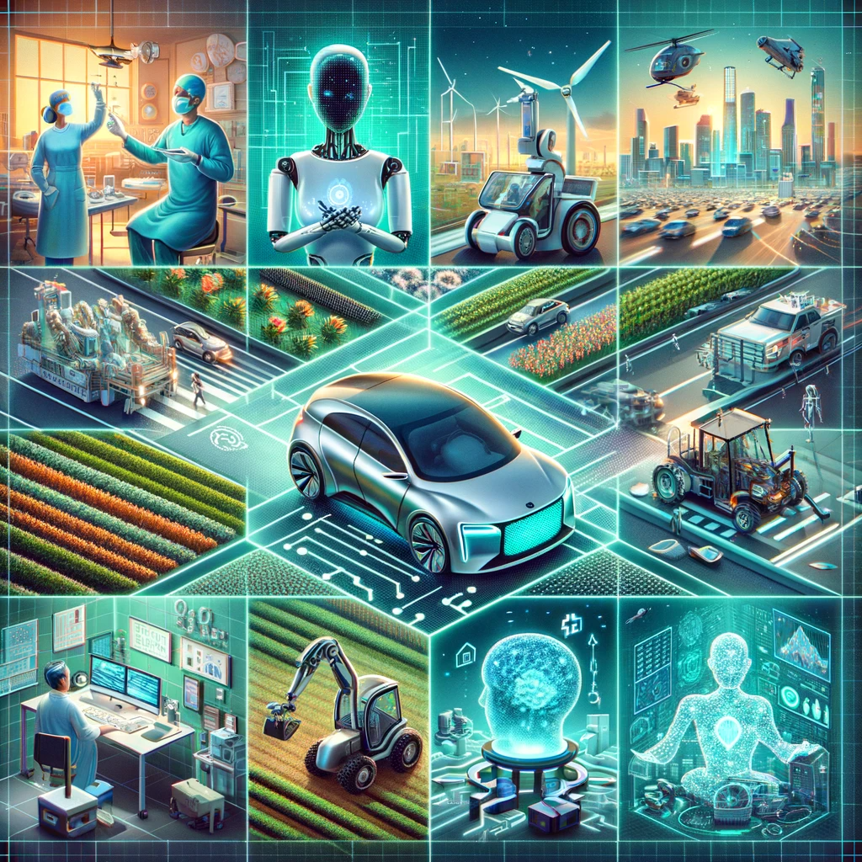
Top Use cases for ai 2024

Slide 18
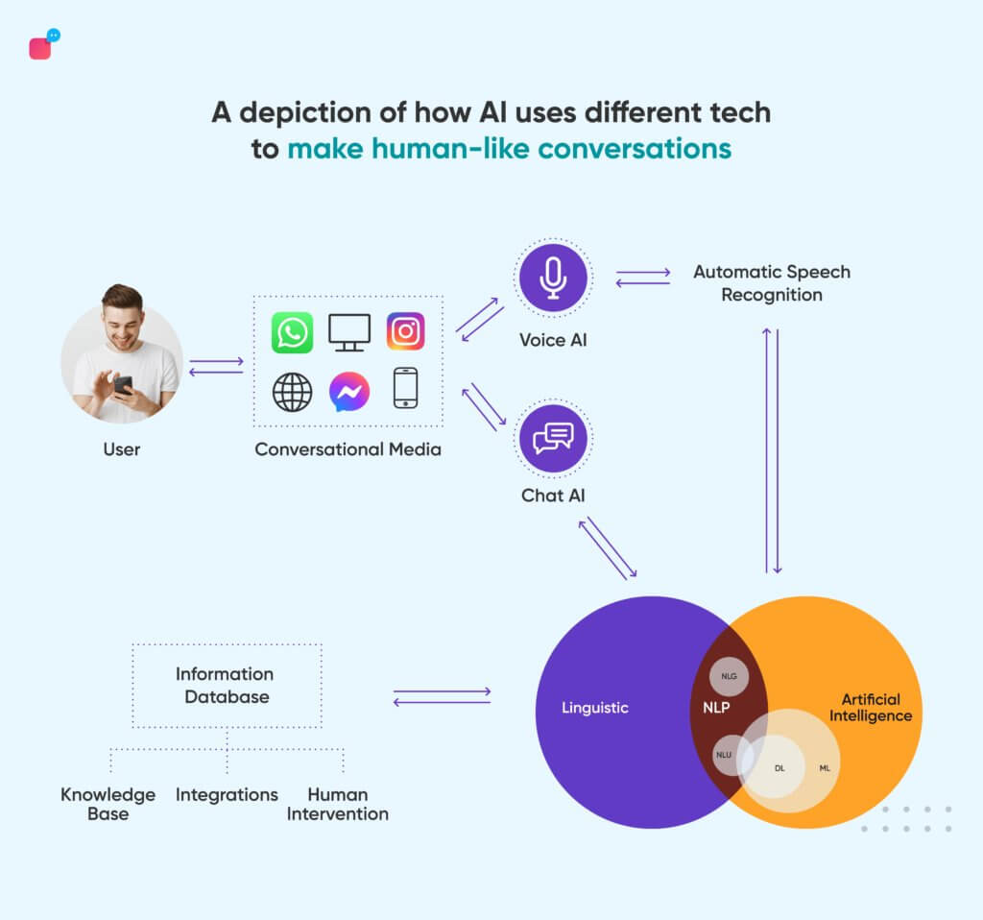
Notes:
https://verloop.io/blog/nlp-chatbots/

Slide 19
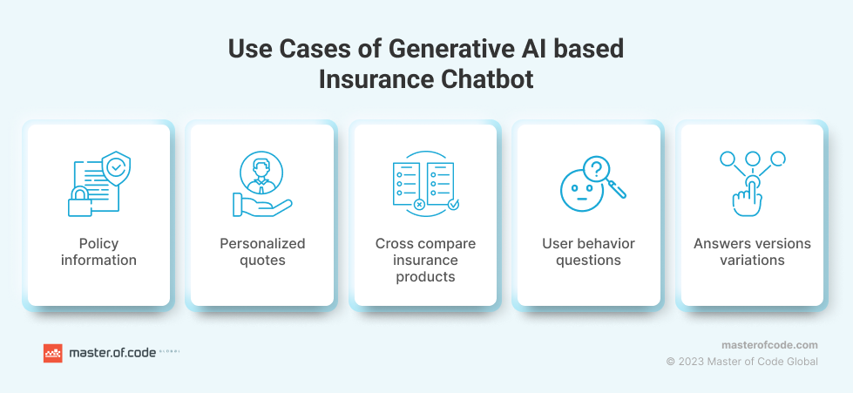
Notes:
https://masterofcode.com/blog/generative-ai-chatbot-for-insurance-use-cases-benefits-and-industry-examples

Slide 20
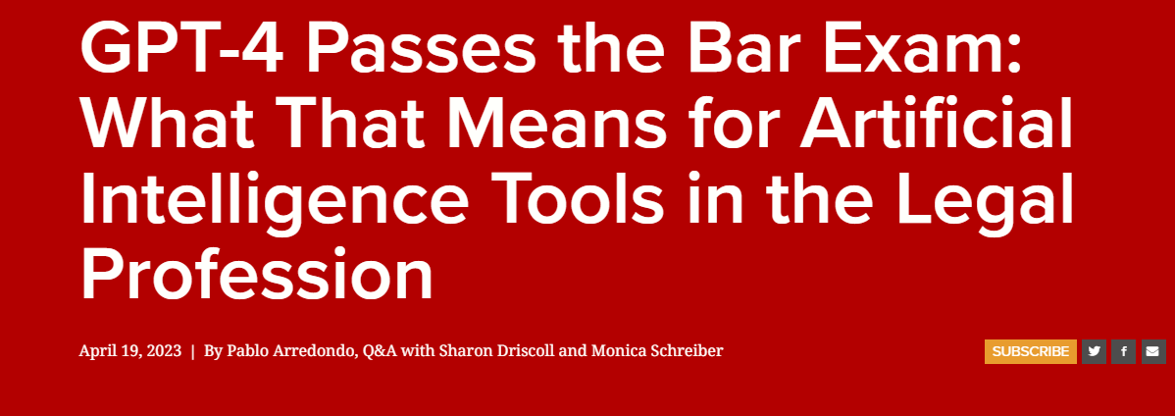
Notes:
https://law.stanford.edu/2023/04/19/gpt-4-passes-the-bar-exam-what-that-means-for-artificial-intelligence-tools-in-the-legal-industry/

Slide 21
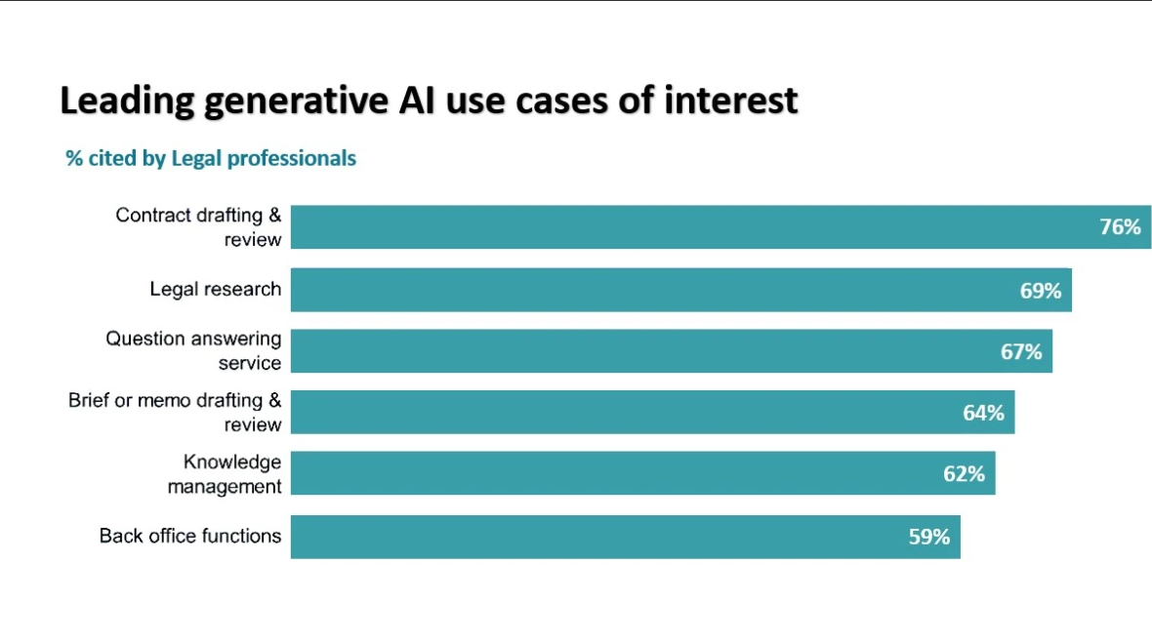
Notes:
https://www.ifourtechnolab.com/blog/top-technology-trends-transforming-the-legal-industry-in-2024

Slide 22
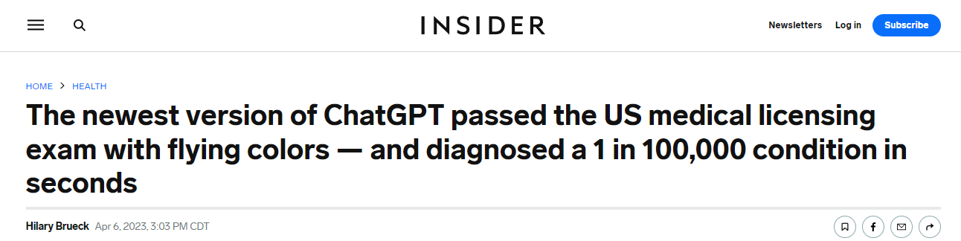
Notes:
https://www.insider.com/chatgpt-passes-medical-exam-diagnoses-rare-condition-2023-4

Slide 23
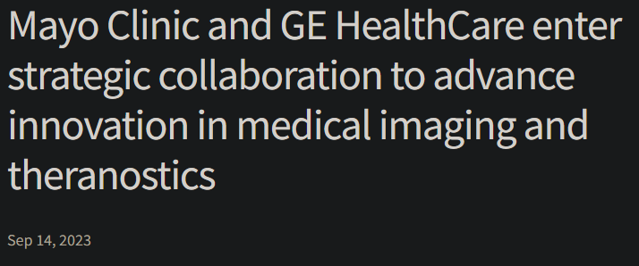
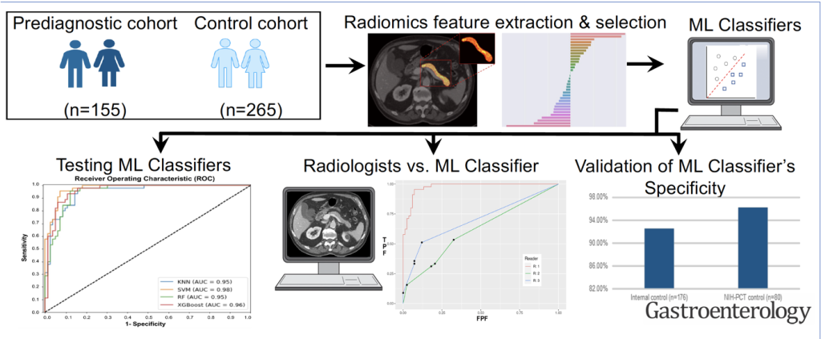
Notes:
https://www.gehealthcare.com/about/newsroom/press-releases/mayo-clinic-and-ge-healthcare-enter-strategic-collaboration-to-advance-innovation-in-medical-imaging-and-theranostics?npclid=botnpclid
https://newsnetwork.mayoclinic.org/discussion/ai-applied-to-prediagnostic-cts-may-help-diagnose-pancreatic-cancer-at-earlier-more-treatable-stage/

Slide 24
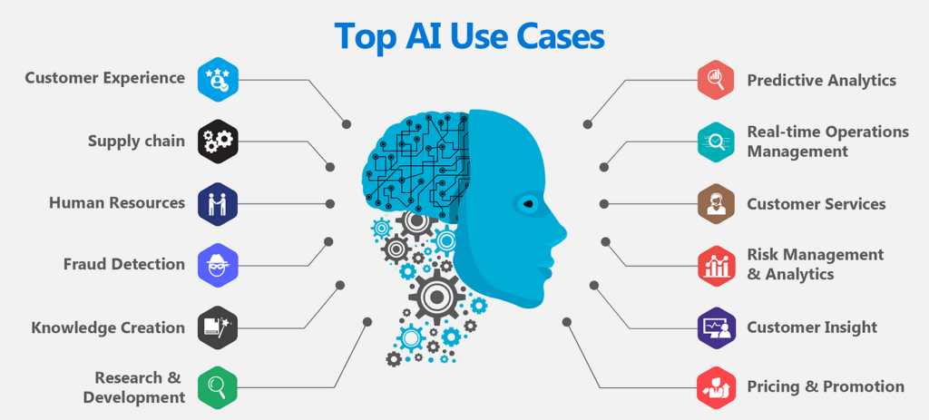
Everything Else…
Notes:
https://mockey.ai/blog/ai-trend/

Slide 25
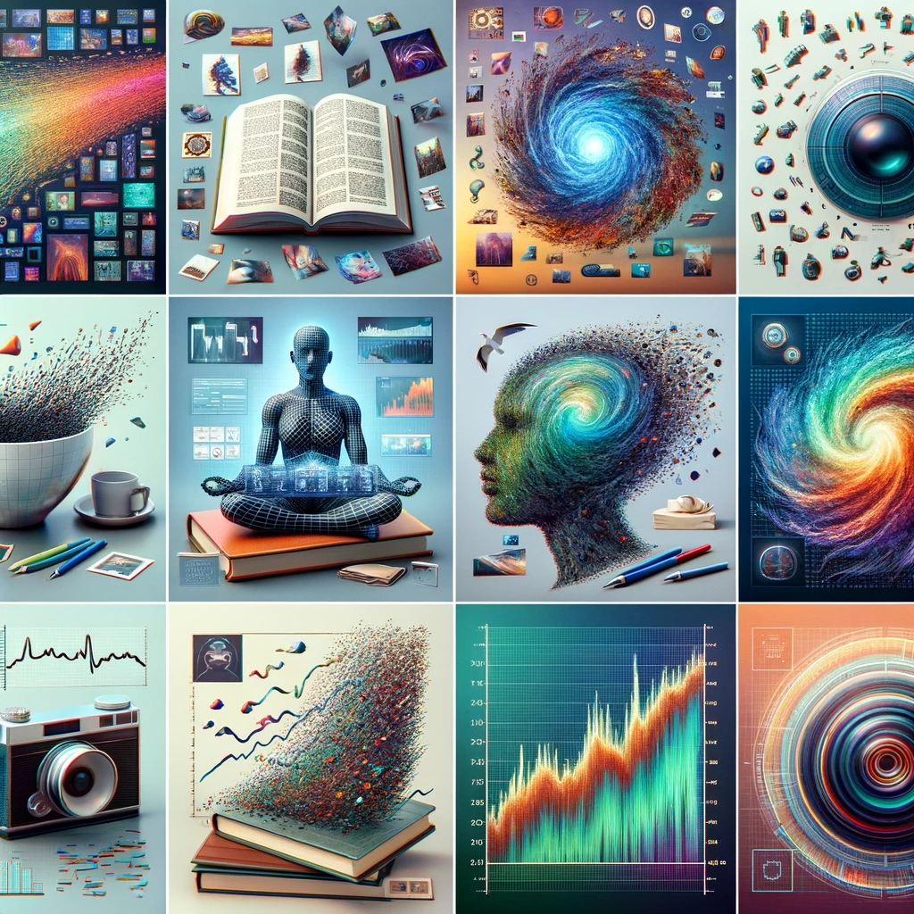
Gen AI Showcase
Notes:
Text: Generative AI models can produce written content ranging from simple text responses, like chatbot replies, to complex compositions such as articles, stories, and code. Examples include GPT (Generative Pre-trained Transformer) models.
Images: AI models can generate realistic images or artworks, modify existing images, or create visualizations from text descriptions. Techniques like Generative Adversarial Networks (GANs) are often used in this space.
Audio: This includes the generation of music, speech synthesis (text-to-speech), and sound effects. Models can be trained to produce new compositions or mimic specific styles or voices.
Video: Generative models can create new video content, which might involve synthesizing realistic video clips or altering existing footage, like deepfakes.
3D Models: AI can generate three-dimensional objects or scenes, which is particularly useful in fields like game development, architecture, and product design.
Time-Series Data: In finance, weather forecasting, or health monitoring, generative AI can produce synthetic time-series data, useful for simulations or to augment limited datasets.

Slide 26
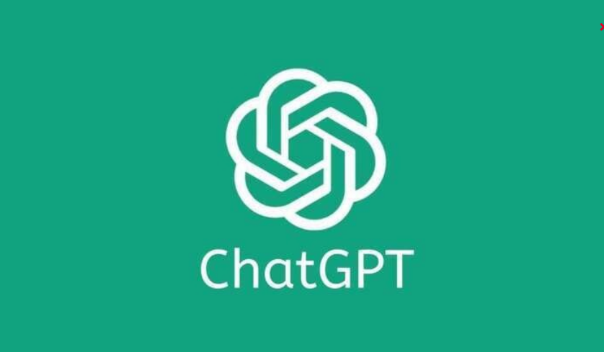
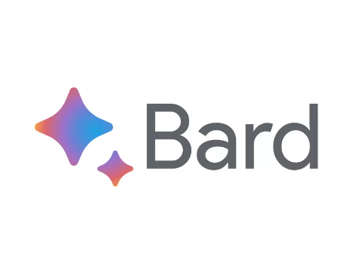
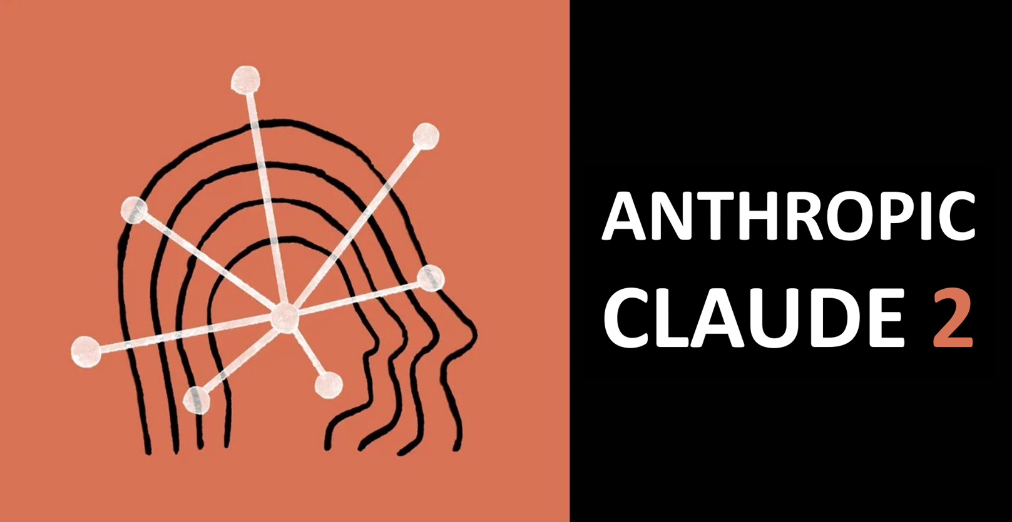
Text Chat – The Big One + the other two
Notes:
https://chat.openai.com/
https://bard.google.com/chat
https://claude.ai/

Slide 27

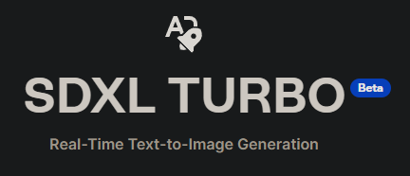
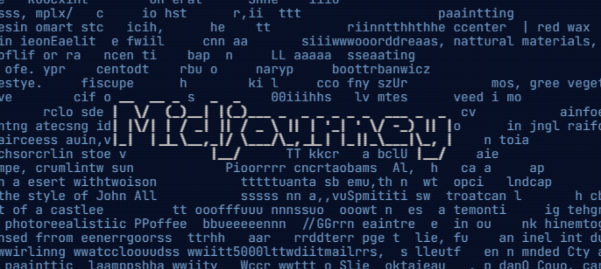
Images
Notes:
https://labs.openai.com/
https://www.midjourney.com/
https://clipdrop.co/stable-diffusion-turbo

Slide 28

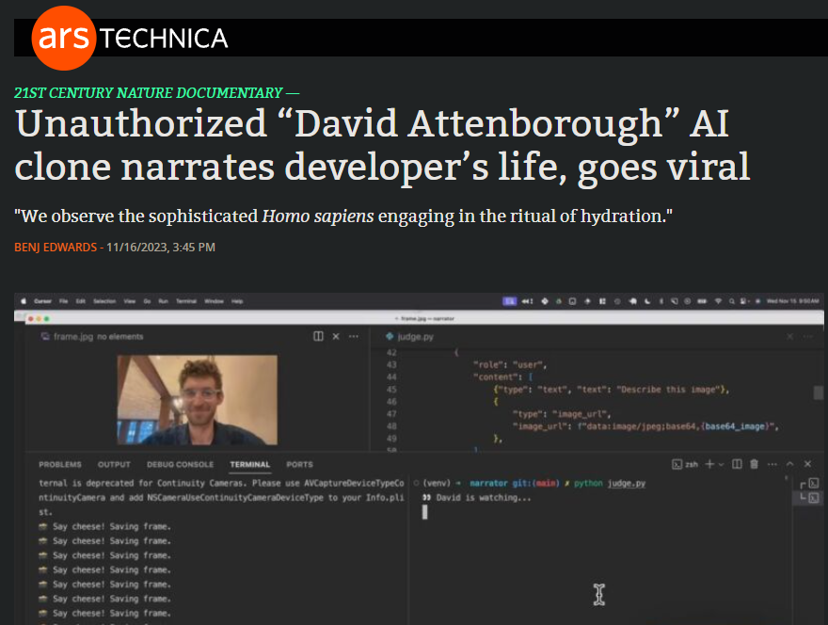
Voice / Audio
Text-to-Speech
Speech-to-Speech
Speech-to-Text
Notes:
https://elevenlabs.io/
https://arstechnica.com/information-technology/2023/11/unauthorized-david-attenborough-ai-clone-narrates-developers-life-goes-viral/

Slide 29
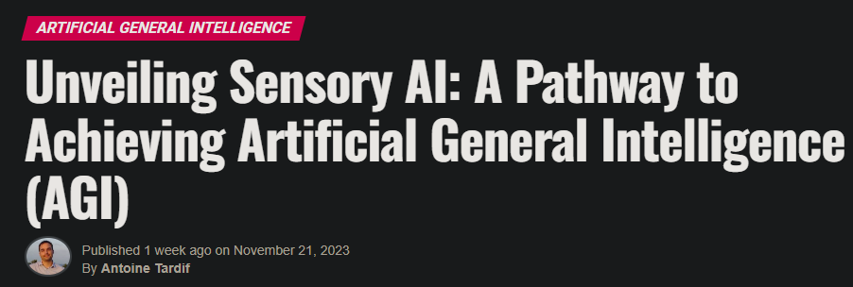
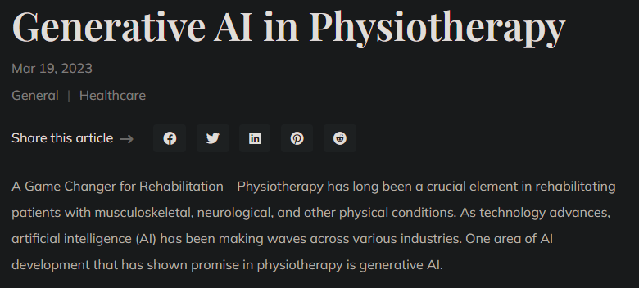
Sensory/ Physical Interaction
Notes:
https://www.unite.ai/unveiling-sensory-ai-a-pathway-to-achieving-artificial-general-intelligence-agi/
https://www.wesleybaker.com/generative-ai-in-physiotherapy/

Slide 30
Getting Started On Your AI Journey

Slide 31
Start using Gen AI in your Daily life
Notes:
https://clipdrop.co/stable-diffusion-turbo

Slide 32






Free / Paid Training
Notes:
https://www.coursera.org/
https://www.pluralsight.com/
https://www.udemy.com/
https://learn.microsoft.com/en-us/training/
https://www.aws.training/
https://cloud.google.com/learn/training/machinelearning-ai

Slide 33
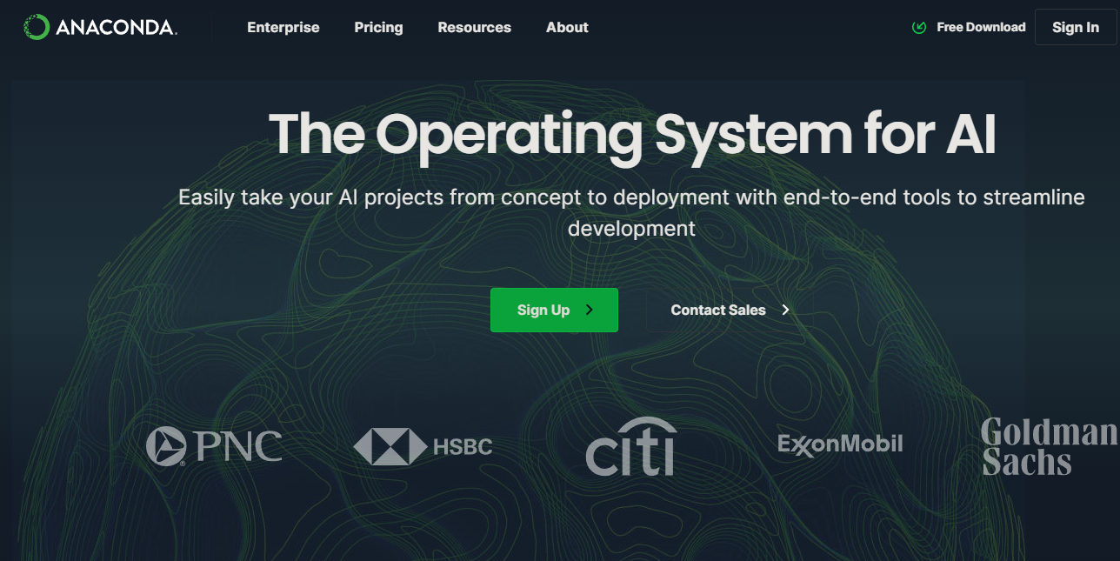
Embrace Python and Anaconda
Notes:
https://www.anaconda.com/

Slide 34
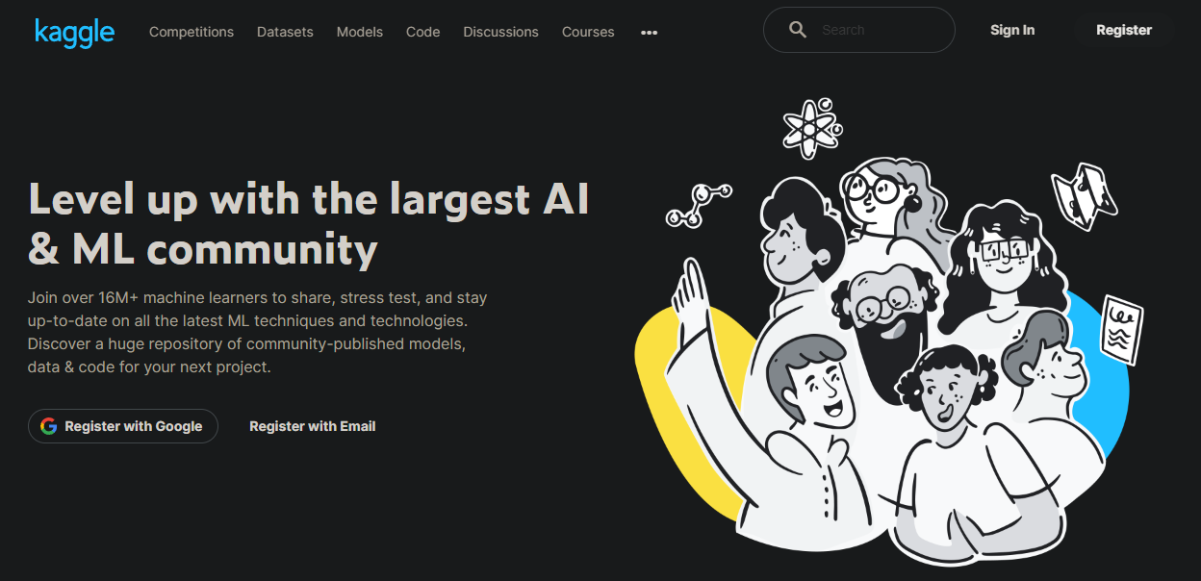
Try a Kaggle Challenge
Notes:
https://www.kaggle.com/

Slide 35




Certifications
Notes:
https://aws.amazon.com/certification/certified-machine-learning-specialty/
https://learn.microsoft.com/en-us/credentials/certifications/azure-data-scientist/
https://learn.microsoft.com/en-us/credentials/certifications/azure-ai-engineer/
https://cloud.google.com/learn/certification/machine-learning-engineer

Slide 36
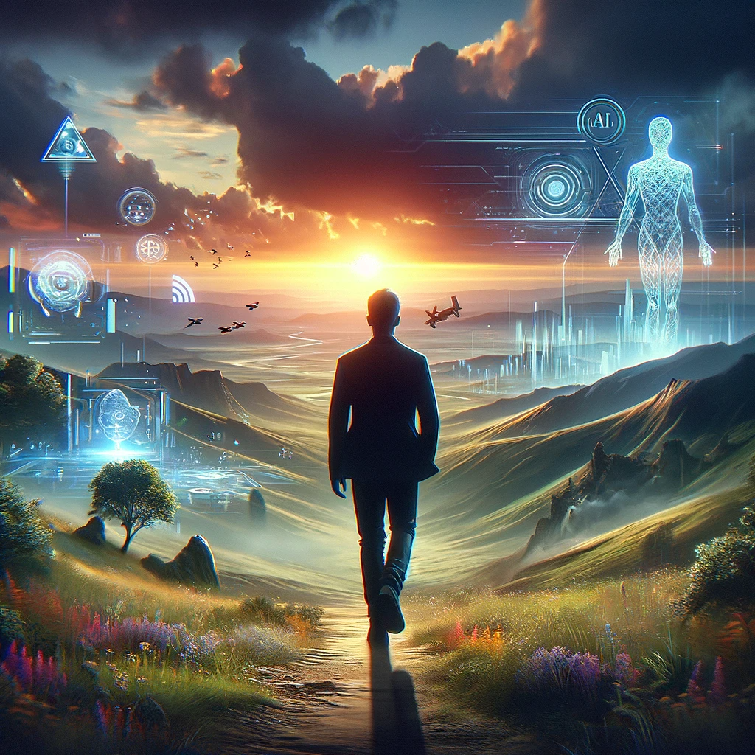
The future has not been written.
There is no fate but what we make for ourselves.
-Sarah Connor
Notes:
https://en.wikipedia.org/wiki/Terminator_2:_Judgment_Day

